Slide 1
Data Management CT051-3-M
Topic 9 – Data Security and Governance

Slide 2
Topic & Structure of Lesson
Data Governance and IT Governance
Key pillars of a Data Governance Program
Challenges Faced
Similarities between Data Governance and Internal Audit
Collaboration

Slide 3

Defining Data Governance
Data governance specifies the framework for decision rights and accountabilities to encourage desirable behavior in the use of data.
The purpose of a Data Governance program is to ensure that data assets are overseen in a cohesive and consistent enterprise-wide manner.

Slide 4

Defining IT Governance
Assists in the achievement of corporate success by both efficiently and effectively deploying secure and reliable information through the application of technology.

Slide 5
Is there are difference?
How do we define data governance and IT governance ?
What’s the relationship between data and information technology?
Alignment
Collaboration
Balance

Slide 6
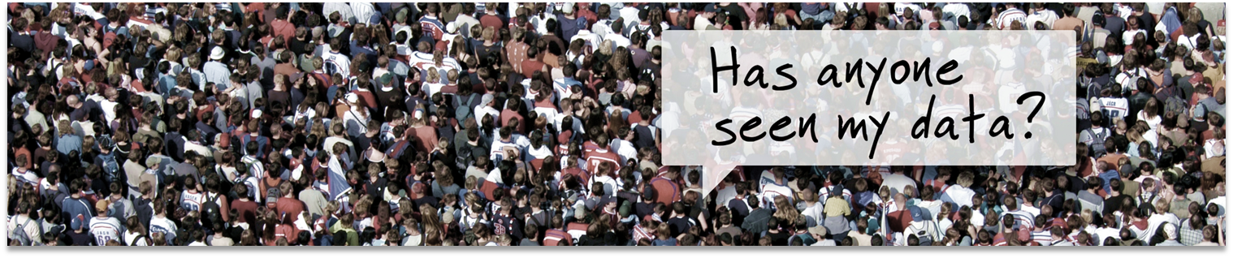
Why do we need Data Governance?
Evolving regulatory requirements
Lack of trust in the integrity of data
Lack of a centralized documentation on the use and meaning of data
Data silos and multiple sources of data
The use and amount of data in organizations has increased exponentially.

Slide 7
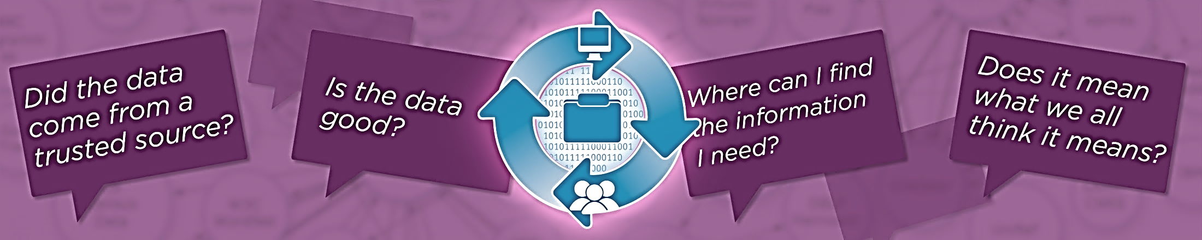
Answering these common questions
A Data Governance Program can capture and share the answers to these types of common data questions …

Slide 8








Who’s responsible for better data?
Information Technology
Human Resources
Quality
Finance
Marketing
Operations
Supply Chain

Slide 9
Information Owner
approve data transfers both internal and external
prioritizing data integrity issues and engaging resources to resolve them
approving data definitions and business terms
participate in Data Governance activities as requested
Data Steward
Application Steward
Analytics Steward
Create and maintain data/business definitions
Assist with defining data access rules, data mappings, and data aggregation methods
Assist with Master Data Management trust rule definitions
Maintain reference tables for codes, descriptions, mappings, and groupings
Named for each application
Populate and maintain an application inventory
Enhance application data collection processes to reduce data integrity issues
Enhance testing/validation of outbound data
Assist with Master Data Management trust rule definitions
Named for each reporting
Populate and maintain a solutions inventory
Reduce duplication of solutions
Define rules for use of standard definitions and report documentation guidelines
Define data release processes and guidelines

Slide 10
Executing a plan…
YEAR THREE
YEAR TWO
Engagement
YEAR ONE
Awareness
Council drives priorities
Begin policy/guideline approval
Information owners govern
Publish data quality metrics
Deploy master data
Deploy metadata
Define and Build
Communicate, communicate
Educate (make it personal)
Begin a data glossary
Begin data profiling
Begin master data efforts
Fill roles for initial efforts
Establish council and office
Define roles aligned with policy
Educate council and staff
Define initial priorities
Acquire and implement tools
Engage Human Resources

Slide 11
Data Governance tasks at a glance
Data integrity
Metadata Management
Ensure data sources are complete and accurate
Define business rules / quality thresholds
Data Integrity Scorecards
Cleanse data at the source
Define terms and definitions across the organization
Define and build data lineage
Reporting initiatives
Master Data Management
Policy / Guidelines
Customer / Product attributes
Facilities/ Location models
Customer/ Product/ Vendor relationships
Code mapping across source systems
Information Ownership
Business Glossary Change Management
Self-Service use of data
Data Movement
Report Documentation

Slide 12

Data Integrity
92% of businesses feel their data is inaccurate in some way. In addition, unreliable, incomplete, or poor-quality data cost organizations between 15% and 20% of their operating budgets – 2013 survey by US Insurance Data Management Association.
Data Profiling is analyzing what the current state of a system’s data IS compared to what it ideally SHOULD be.
Why profile?
Raises awareness of where data collection processes can be improved.
Provides direction on developing data quality standards.
Sets the foundation for exception reporting, Invalids = Errors or Warnings.
Helps us determine “Is this data fit for use?”

Slide 13


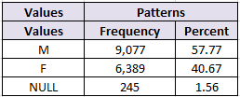

Data Integrity
Questions to the business/ application
Are nulls okay or expected?

Slide 14


Metadata Management
What is the definition of the data element
What is the associated reference data
Are there synonyms or aliases
What source did this data originate from
Are there related terms
Are any business rules applied to the data

Slide 15






Master Data Management
SSN
*****6789
First Name
John
MI
M.
Last Name
Smith
Address
600 Grant Street
City
Pittsburgh
State
PA
Zip
15219
Phone
4126475000
Marital Status
Married
Customer
Gold Record
Fields with the highest trust score survive in the final consolidated “gold” record.
SSN
123456789
First Name
John
MI
M
Last Name
Smith
Address
200 Lothrop St.
City
Pittsburgh
State
PA
Zip
15213
Phone
4126478345
System A
SSN
123456789
First Name
John
MI
M
Last Name
Smith
Address
600 Grant Street
City
Pittsburgh
State
PA
Zip
15219
Phone
4126475000
Marital Status
S
System B
SSN
123456780
First Name
Jon
MI
Last Name
Smith
Address
601 Grant Street
City
Pittsburgh
State
PA
Zip
15219
Phone
4126475100
Marital Status
Married
System C

Slide 16
Reference Table Management
System A - Gender Code Set
Local Gender Code | Local Gender Description
1 | Male
2 | Female
3 | Unknown
System B - Gender Code Set
Local Gender Code | Local Gender Description
M | Man
W | Woman
N | Not Known
System C - Sex Code Set
Local Gender Code | Local Gender Description
M | Male
F | Female
U | Unknown
F. | Female
MDM - Gender Reference Table
Standard Gender Code | Standard Gender Description
M | Male
F | Female
U | Unknown
System A - Local Gender Code | System B - Local Gender Code | System C - Local Gender Code
1 | M | M
2 | W | F
3 | N | U
 |  | F.
Standardization

Slide 17
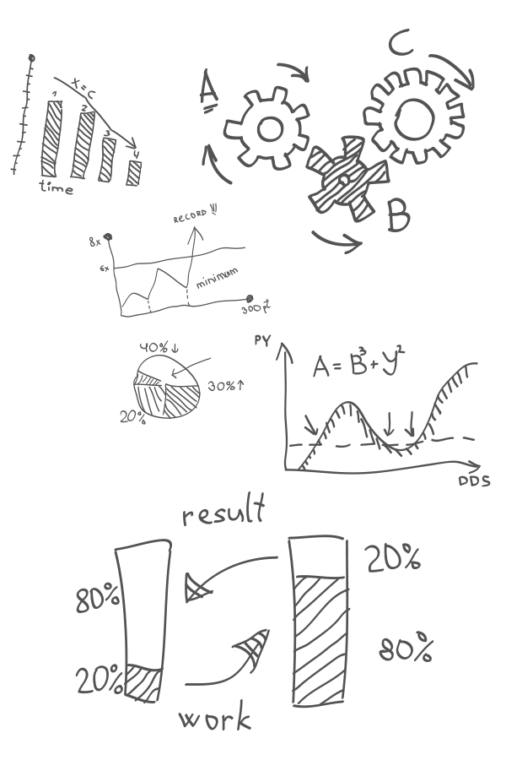
Challenges…
Engage the organization, but avoid hype.
Name only those you plan to engage soon.
Continuously communicate and educate.
Diversify early but be careful not to overcommit.
Use real data examples to educate.
Senior Executives must be actively engaged.
Be resilient, this is a program, not a project.
Don’t quit. Passion works.

Slide 18
Data Governance and Internal Audit
A comprehensive and effective data governance program encompasses people, processes, policies, controls and technology. In addition, a critical element of a data governance program involves educating key stakeholders about the benefits of data governance and the risks associated with poor data quality, integrity, and security.
A comprehensive and effective internal audit program encompasses people, processes, policies, controls and technology. In addition, a critical element of a internal audit program involves educating key stakeholders about the benefits of internal audit and the risks associated with poor data quality, integrity, and security.

Slide 19
Data Governance and Internal Audit
Knowledgeable of IT and operational aspects of the organization
Developing and maintaining relationships
Communication and Education
Managing push back/ culture shift
Dealing with data-related risk

Slide 20
Collaboration with Internal Audit
Data Governance Program Maturity
Enhancing Program scope and objectives
Development of Policies and Standards
Example of a two ways Internal Audit and Data Governance can collaborate

Slide 21

Summary Recap
How do we define Data Governance and its relationship to IT Governance.
What are some of the key pillars of a Data Governance Program.
What challenges does a Data Governance Program face early on.
How can Data Governance and Internal Audit collaborate or leverage each other.
Better Data is Everyone’s Job

Slide 22
Question & Answer Session
Q & A
Notes:
Acknowledgement - Matt Slavonic - slavonicmm@upmc.edu

